Slide 1
Instrumental Variables Beating endogeneity…with music? by Ralf Martin (r.martin@imperial.ac.uk)

Slide 2
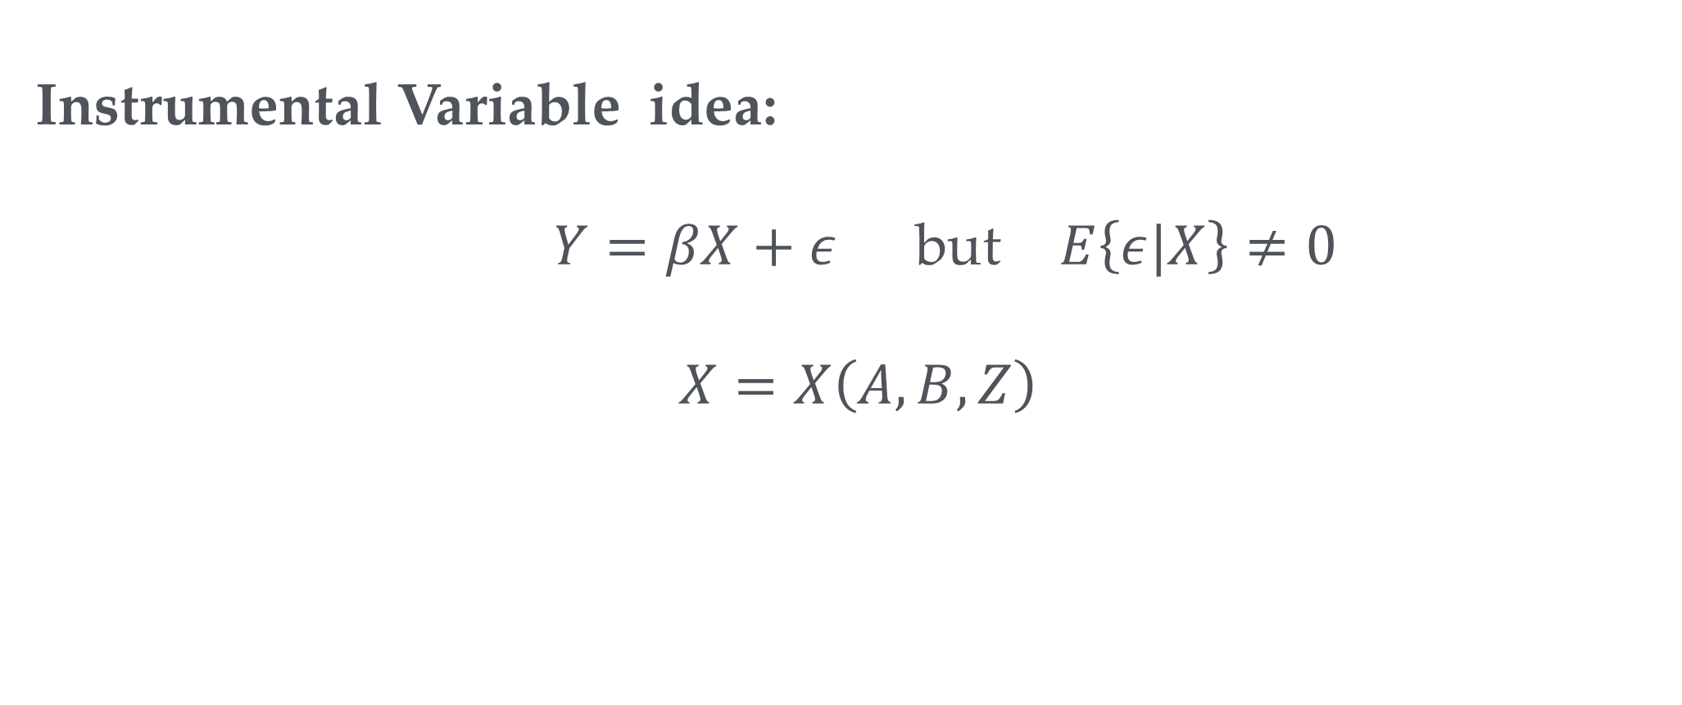
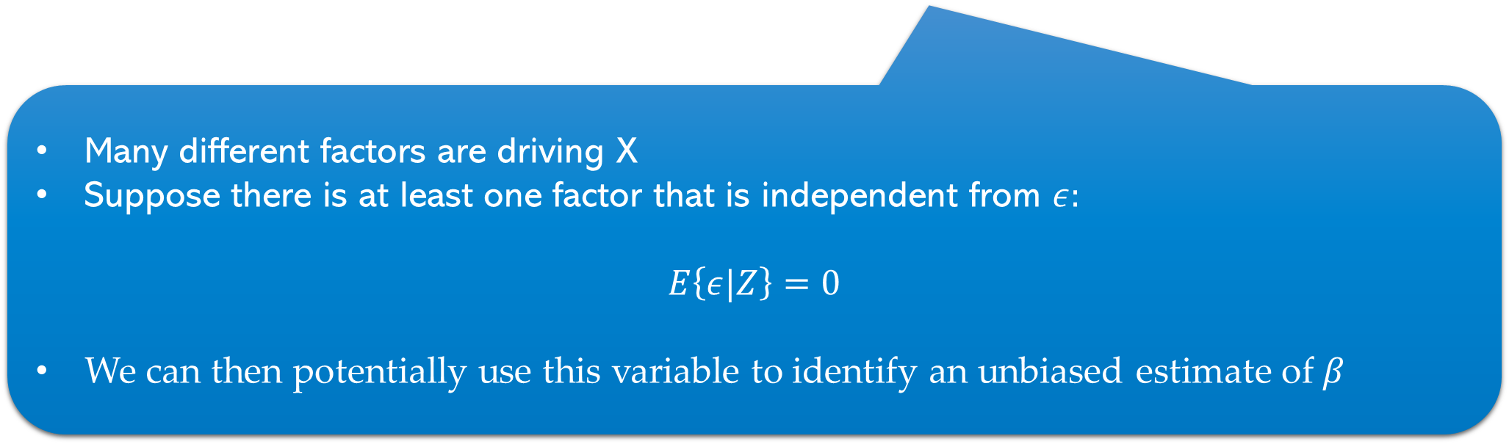
Fixing endogeneity
Endogeneity Problem
Instrumental Variable idea:
$Y=βX+ε$but $E\left\{ε|X\right\}≠0$
$$X=X\left(A, B, Z\right)$$
Many different factors are driving X
Suppose there is at least one factor that is independent from $ε:$
$$E\left\{ε|Z\right\}=0$$
We can then potentially use this variable to identify an unbiased estimate of $β$

Slide 3
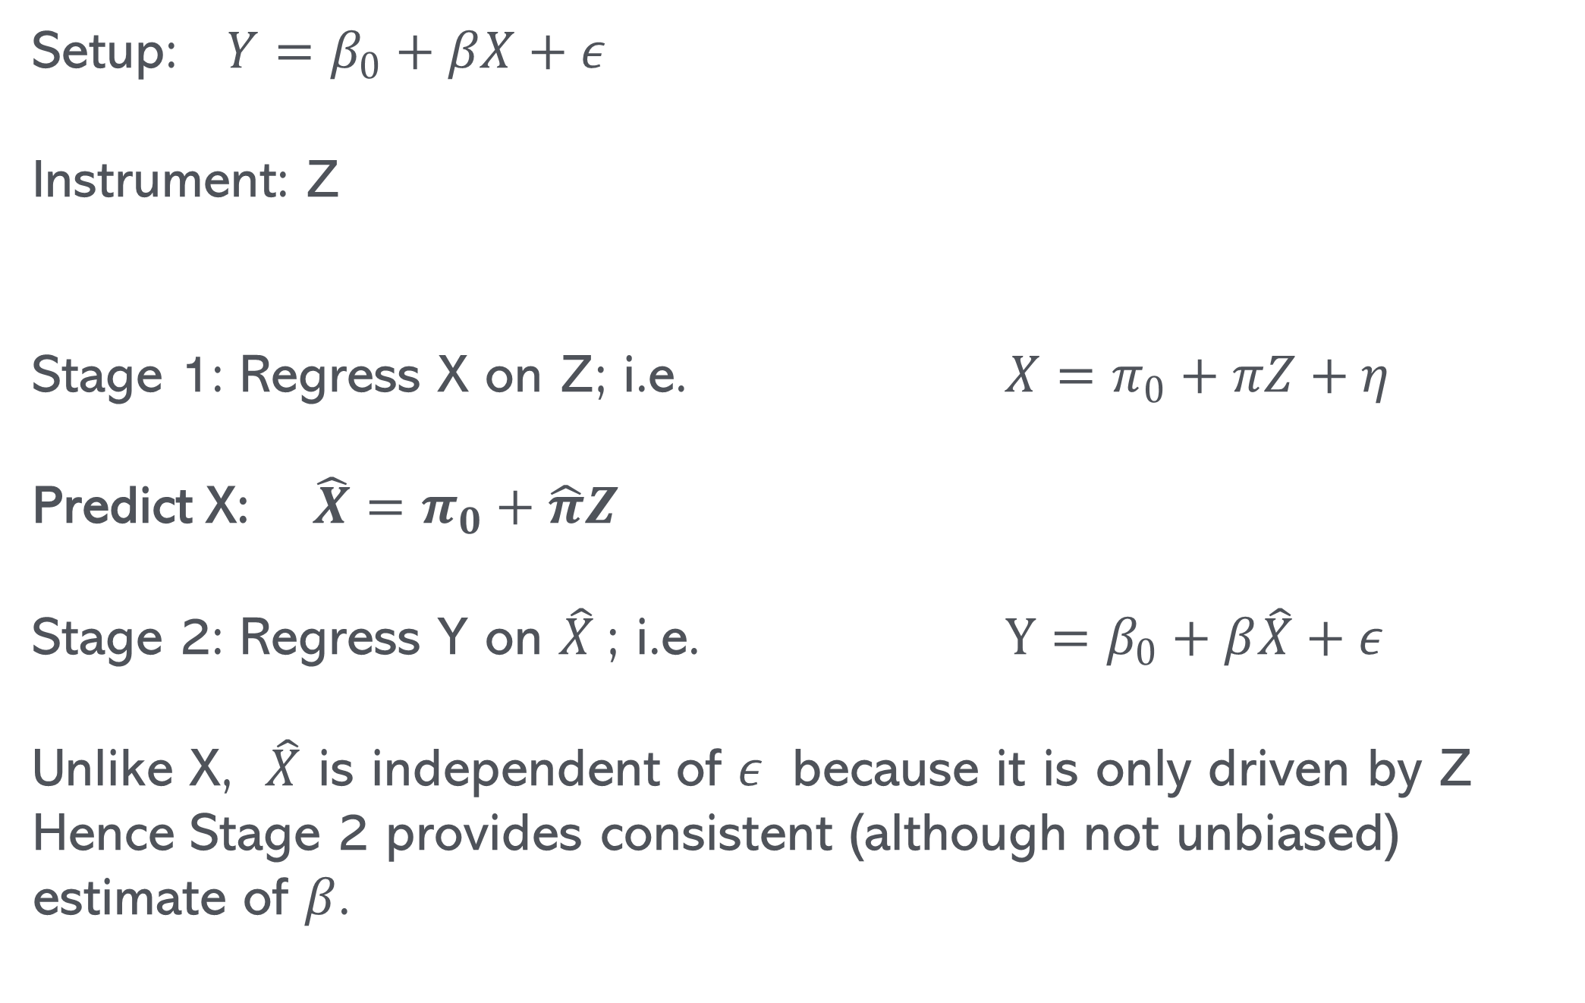
2 Stage Least Squares Estimator (2 SLS)
Setup: $Y=β_{0}+βX+ε$
Instrument: Z
Stage 1: Regress X on Z; i.e. $X=π_{0}+πZ+η$
Predict X: $\hat{X}=π_{0}+\hat{π}Z$
Stage 2: Regress Y on $\hat{X}$; i.e. $Y=β_{0}+β\hat{X}+ε$
Unlike X, $\hat{X}$ is independent of $ε$ because it is only driven by Z
Hence Stage 2 provides consistent (although not unbiased) estimate of $β$.

Slide 4
Schooling effects example
Super nerd
+
-
$$Wage=βEducation+ε$$
+
+
Academic Talent
Cost of attending college
Closeness to college
See also paper by Card 1993

Slide 5
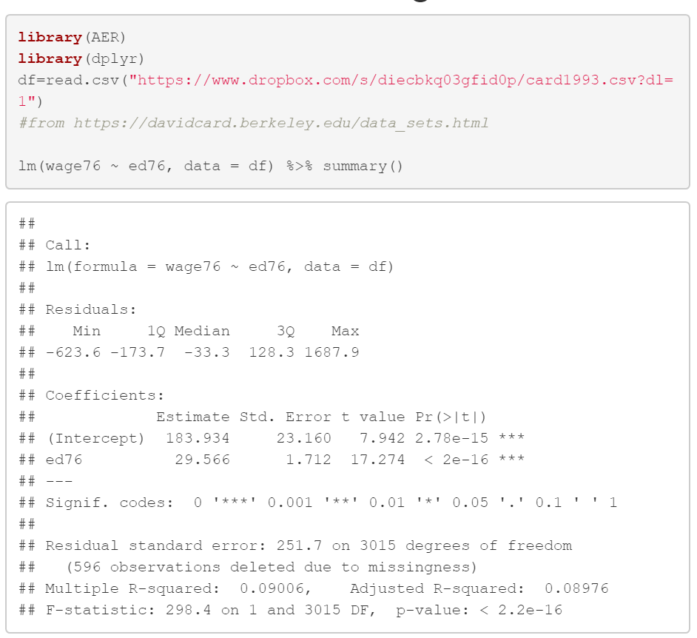
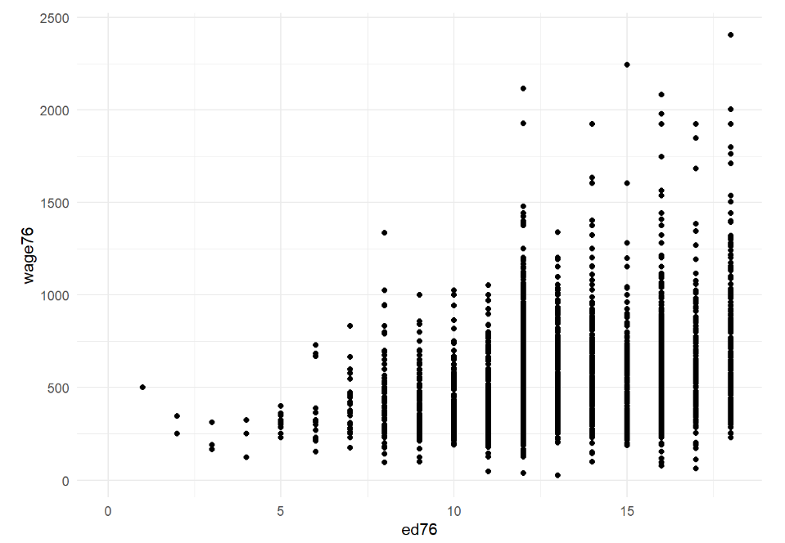
Schooling example
For every additional year of education $30 more

Slide 6
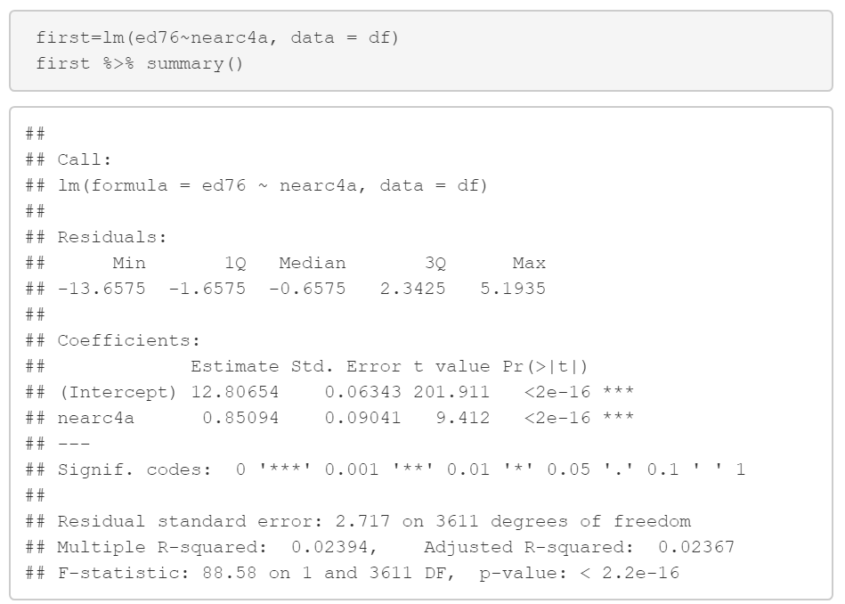
Schooling example: The distance instrument
If you grow up near a public 4 year college you have nearly an additional year of education on average
Note that this is super significant (including high F)

Slide 7
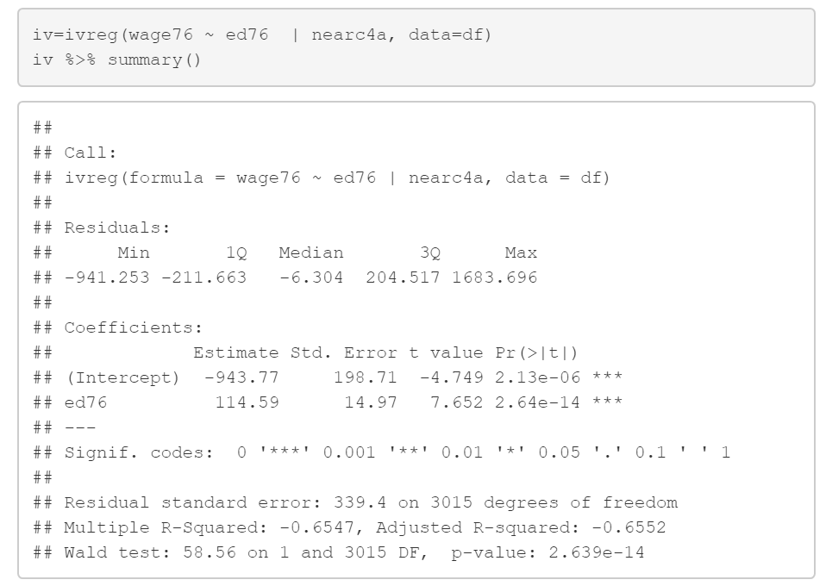
Implementing IV
New regression command to implement 2SLS
Seems the effect of education is stronger than thought: an extra $114 for every year
Could mean
In OLS case we had downward bias
Could be indicative of problem with IV

Slide 8


A graphical representation of IV
$$Y=Xβ+ϵ$$
Criterion 3
Criterion 2
Criterion 1
$$Z$$
Must be argued
3 Criteria for instrumental variables
Can be checked
Must be independent of shocks
Must be driver of variable of interest
Must not affect outcome variable other than trough variable of interest
Must be argued

Slide 9

The College distance instrument
$$Wage=EDUβ+ϵ$$
Criterion 3
Criterion 2
Criterion 1
Near College
Places with opportunities (e.g. cities)
Violation of criterion 3

Slide 10

Conditional IV
Conditioning/Control Variables e.g. controls for nice places
$$Wage=βEDU+β_{2}X+η$$
Criterion 2
Criterion 3
Criterion 1
Near College
Places with opportunities (e.g. cities)

Slide 11
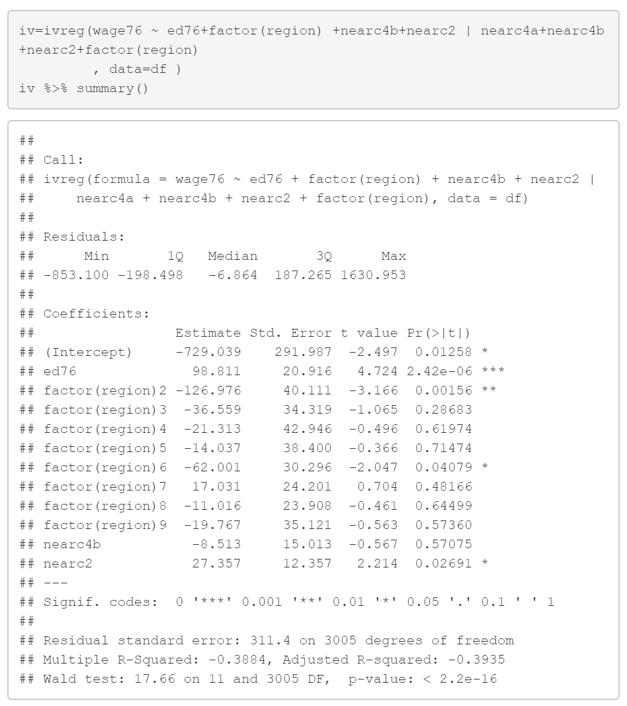
Conditional IV in action
Conditioning/Control Variables e.g. controls for nice places
Education coefficient remains high and significant

Slide 12
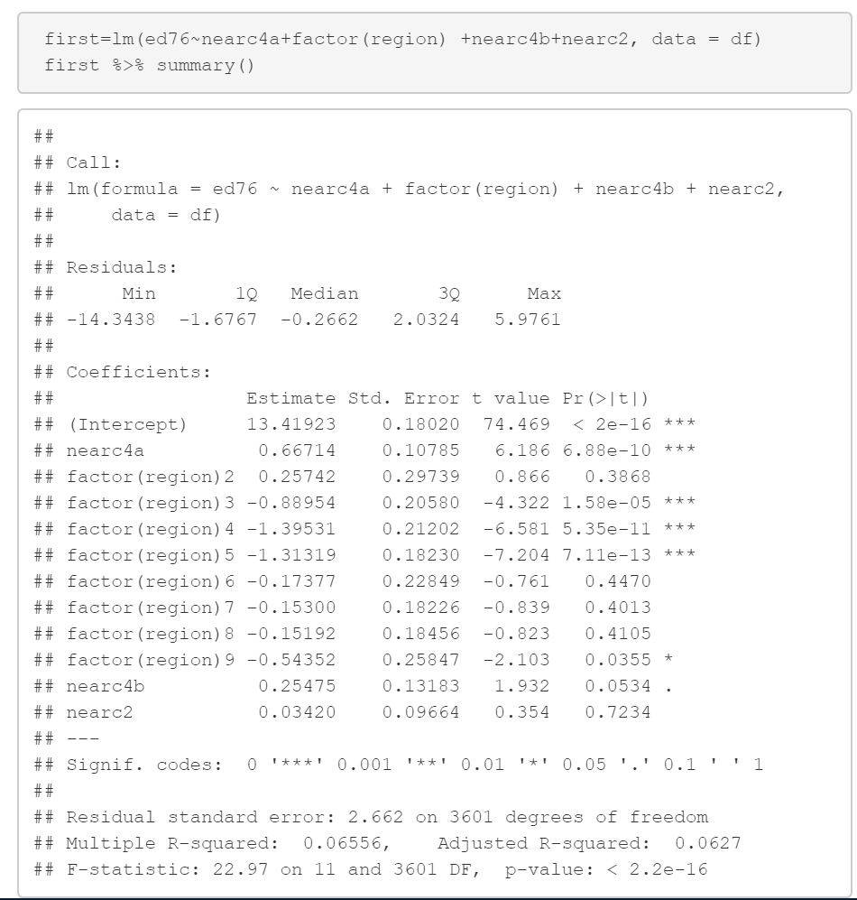
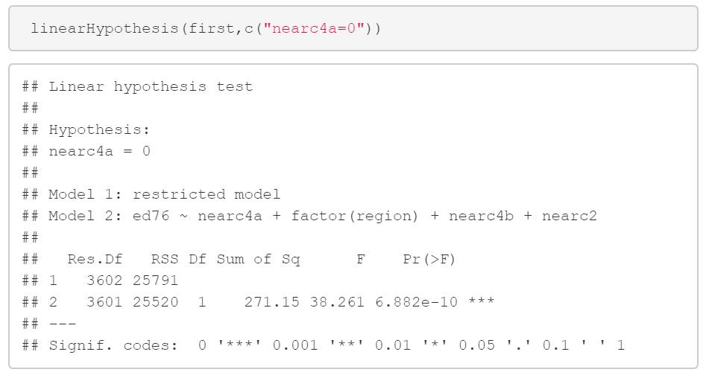

Checking first stage in conditional IV case
However we need a super strong IV
Rule of thumb: F-stat of H0: Z=0 >10
IV still significant

Slide 13
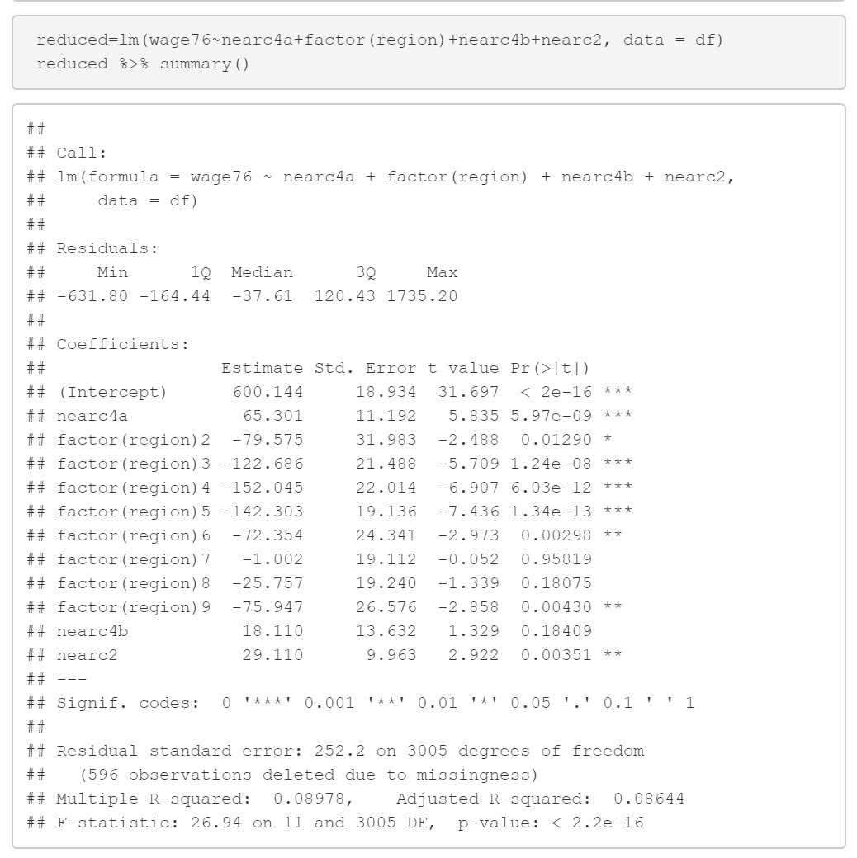
Reduced form: regressing outcome on instrument
If reduced form is not significant IV won’t be either

Slide 14
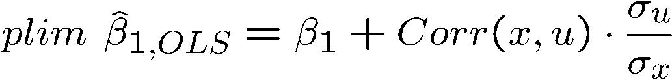
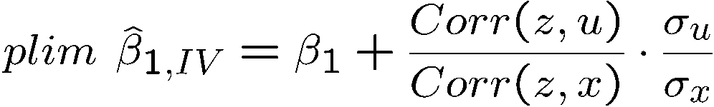
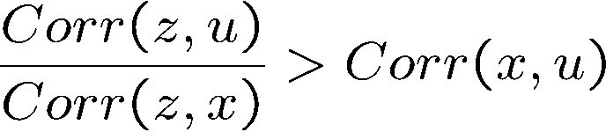
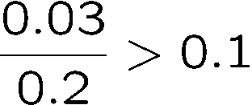
plim = Probability limit
Estimator is consistent if the probability limit is equal to true parameter.
Note 2SLS IV is consistent but not unbiasd
IV health warning
Don’t mess with weak instruments
Properties of IV with a poor instrumental variable
IV may be much more inconsistent than OLS if the instrumental variable is not completely exogenous and only weakly related to explanatory var x
There is no problem if the instrumental variable is really exogenous. If not, the asymp-totic bias will be the larger the weaker the correlation with x.
IV worse than OLS if:
e.g.
That’s why we want the first stage F-statistic to be large!

Slide 15

Extra Slides

Slide 16
More instrumental variable examples

Slide 17

Additional controls many IV’s example: Family size
$$Y=βFamSize+ε$$
Are large families good or bad?
What do you think?
Many potential confounders. Family size is by and large a choice
Poorer and less educated parents tend to have more kids
The same factors could drive outcomes

Slide 18
Family size and children outcomes
(Study by Angrist, Lavy & Schlosser)
However, there is randomness in family size as well
Two factors that are out of control of controlling parents:
Occurrence of twins
Sex of baby
Ok those might meet criteria 1 from earlier but how about criteria 2?
Twins: families might only have planned for 2 kids, but when they had twins they un-intentionally had 3
Many families have preference for a sex mix (a boy and a girl)
Hence, if they have two kids of the same sex they are more likely to carry on having more kids

Slide 19
Second stage

Slide 20
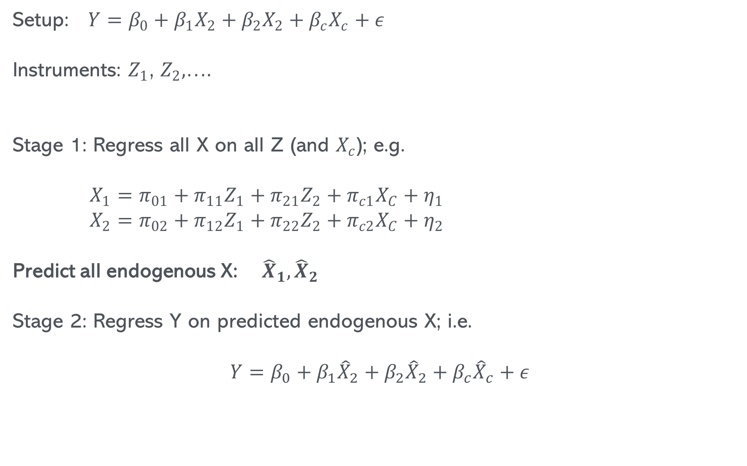
2SLS with multiple instruments & multiple endogenous explanatory variables
Setup: $Y=β_{0}+β_{1}X_{2}+β_{2}X_{2}+β_{c}X_{c}+ε$
Instruments: $Z_{1}$, $Z_{2},$….
Stage 1: Regress all X on all Z (and $X_{c}$); e.g.
$X_{1}=π_{01}+π_{11}Z_{1}+π_{21}Z_{2}+π_{c1}X_{C}+η_{1}$
$X_{2}=π_{02}+π_{12}Z_{1}+π_{22}Z_{2}+π_{c2}X_{C}+η_{2}$
Predict all endogenous X: ${\hat{X}}_{1},{\hat{X}}_{2}$
Stage 2: Regress Y on predicted endogenous X; i.e.
$$Y=β_{0}+β_{1}{\hat{X}}_{2}+β_{2}{\hat{X}}_{2}+β_{c}{\hat{X}}_{c}+ε$$
At least as many Z as endogenous X

Slide 21


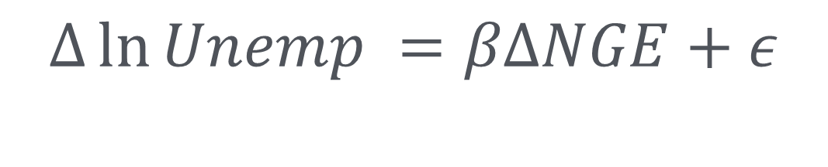
Another example:
Subsidies and Unemployment
$$Δ\ln{Unemp} =βΔNGE+ε$$
Change in (log) unemployment between 2002 and 1997
Change in support rate

Slide 22

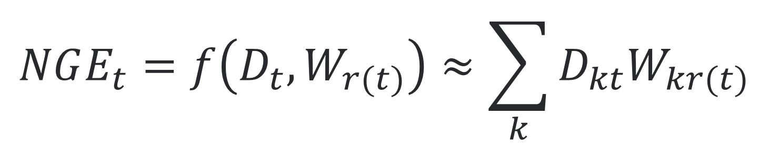
Instrument construction
Know your history
How much support an area gets is based on how
Various indicators of past deprivation (GDP, unemployment, etc.)
Weightings for different indicators
In reality not linear but let’s use as approximation
$$NGE_{t}=f\left(D_{t},W_{r(t)}\right)≈\sum_{k}{D_{kt}W_{kr(t)}}$$
Indicators of Deprivation
Rules that apply in period t. Change every 7 years; e.g. in 2000
Weights of different indicators (Determined by EU rules)

Slide 23

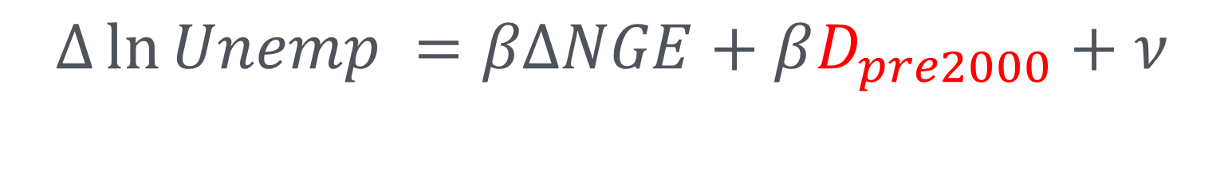

Instrument construction
Conditional IV
$$Δ\ln{Unemp} =βΔNGE+βD_{pre2000}+ν$$
$ΔNGE=\sum_{k}{D_{k,2002}W_{k,post2000}}$-$D_{k,1997}W_{k,pre2000}$
$ΔZ=\sum_{k}{D_{k,pre2000}W_{k,post2000}}$-$D_{k,pre2000}W_{k,pre2000}$
After controlling for $D_{k,pre2000}$, $ΔZ$ does no longer depend on $ν$ and thus becomes valid instrument

Slide 24
Implementation
df=read.csv( "https://www.dropbox.com/s/8pdffaq268v7m8o/unempprep.csv?dl=1")
# Simple OLS regOLS=lm( DDDln1Punemp ~ DDDNGE ,df) summary(regOLS)
## ## Call: ## lm(formula = DDDln1Punemp ~ DDDNGE, data = df) ## ## Residuals: ## Min 1Q Median 3Q Max ## -3.5451 -0.1907 0.0165 0.2109 2.8601 ## ## Coefficients: ## Estimate Std. Error t value Pr(>|t|) ## (Intercept) -0.462220 0.003648 -126.703 < 2e-16 *** ## DDDNGE -0.221062 0.036012 -6.138 8.62e-10 ***
A change in support from 0 to 10% (0-0.1) will reduce unemployment by 2.2%

Slide 25

IV
$$ΔZ$$
A change in support from 0 to 10% (0-0.1) will reduce unemployment by 4.5%

Slide 26
First Stage
The IV variable is called DDDxnivav

Slide 27
F-test of Z=0
F statistic is larger 10…hurray!!!

Slide 28
Reduced Form
IF reduced form is not significant IV will not be either

Slide 29
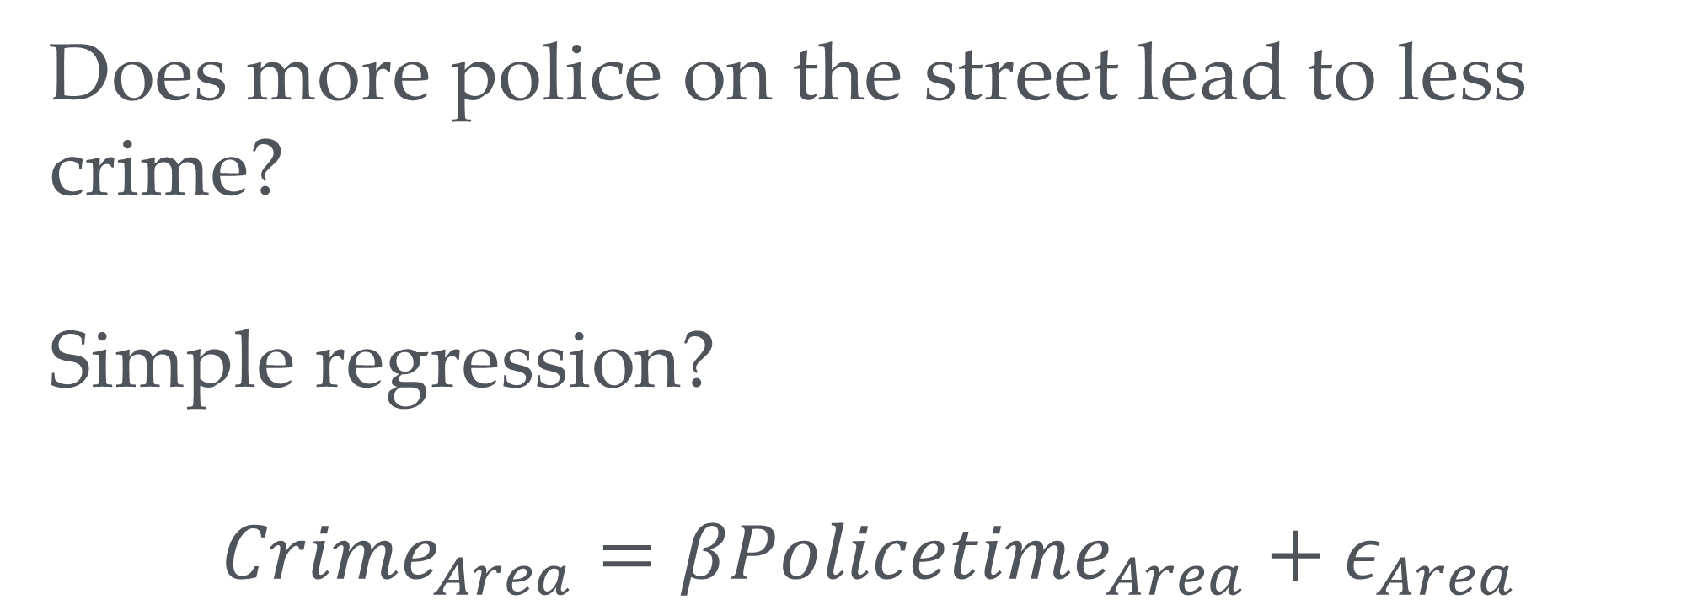
Panic on the streets of London (Study by Draca, Machin and Witt)
→
Does more police on the street lead to less crime?
Simple regression?
$$Crime_{Area}=βPolicetime_{Area}+ε_{Area}$$
Police go where the crime is

Slide 30
Panic on the streets of London (Study by Draca, Machin and Witt)
→
Solution:
Use as instrument
July 7 bombings of 2005 led to increases in police in certain areas (central London, near tube stations) which had nothing to do with crimes such as pick pocketing etc.
Results: 10% more police activity reduces crime by 3 to 4 percent.

Slide 31
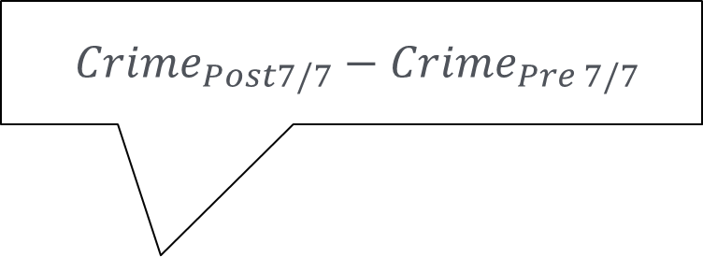
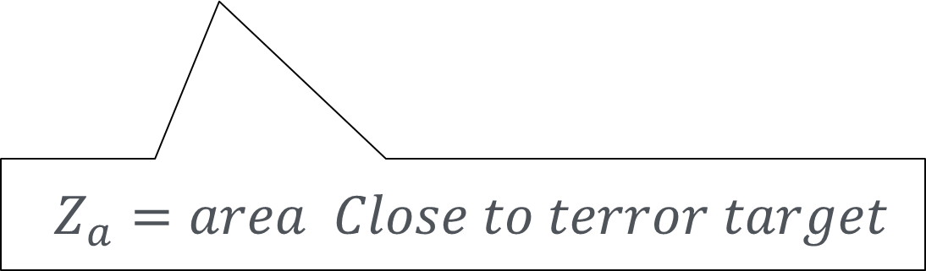
Panic on the streets of London
$Crime_{Post7/7}−Crime_{Pre 7/7}$
$$ΔCrime_{a}=βΔPolice_{a}+ε_{a}$$
$Z_{a}=area Close to terror target$

Slide 32
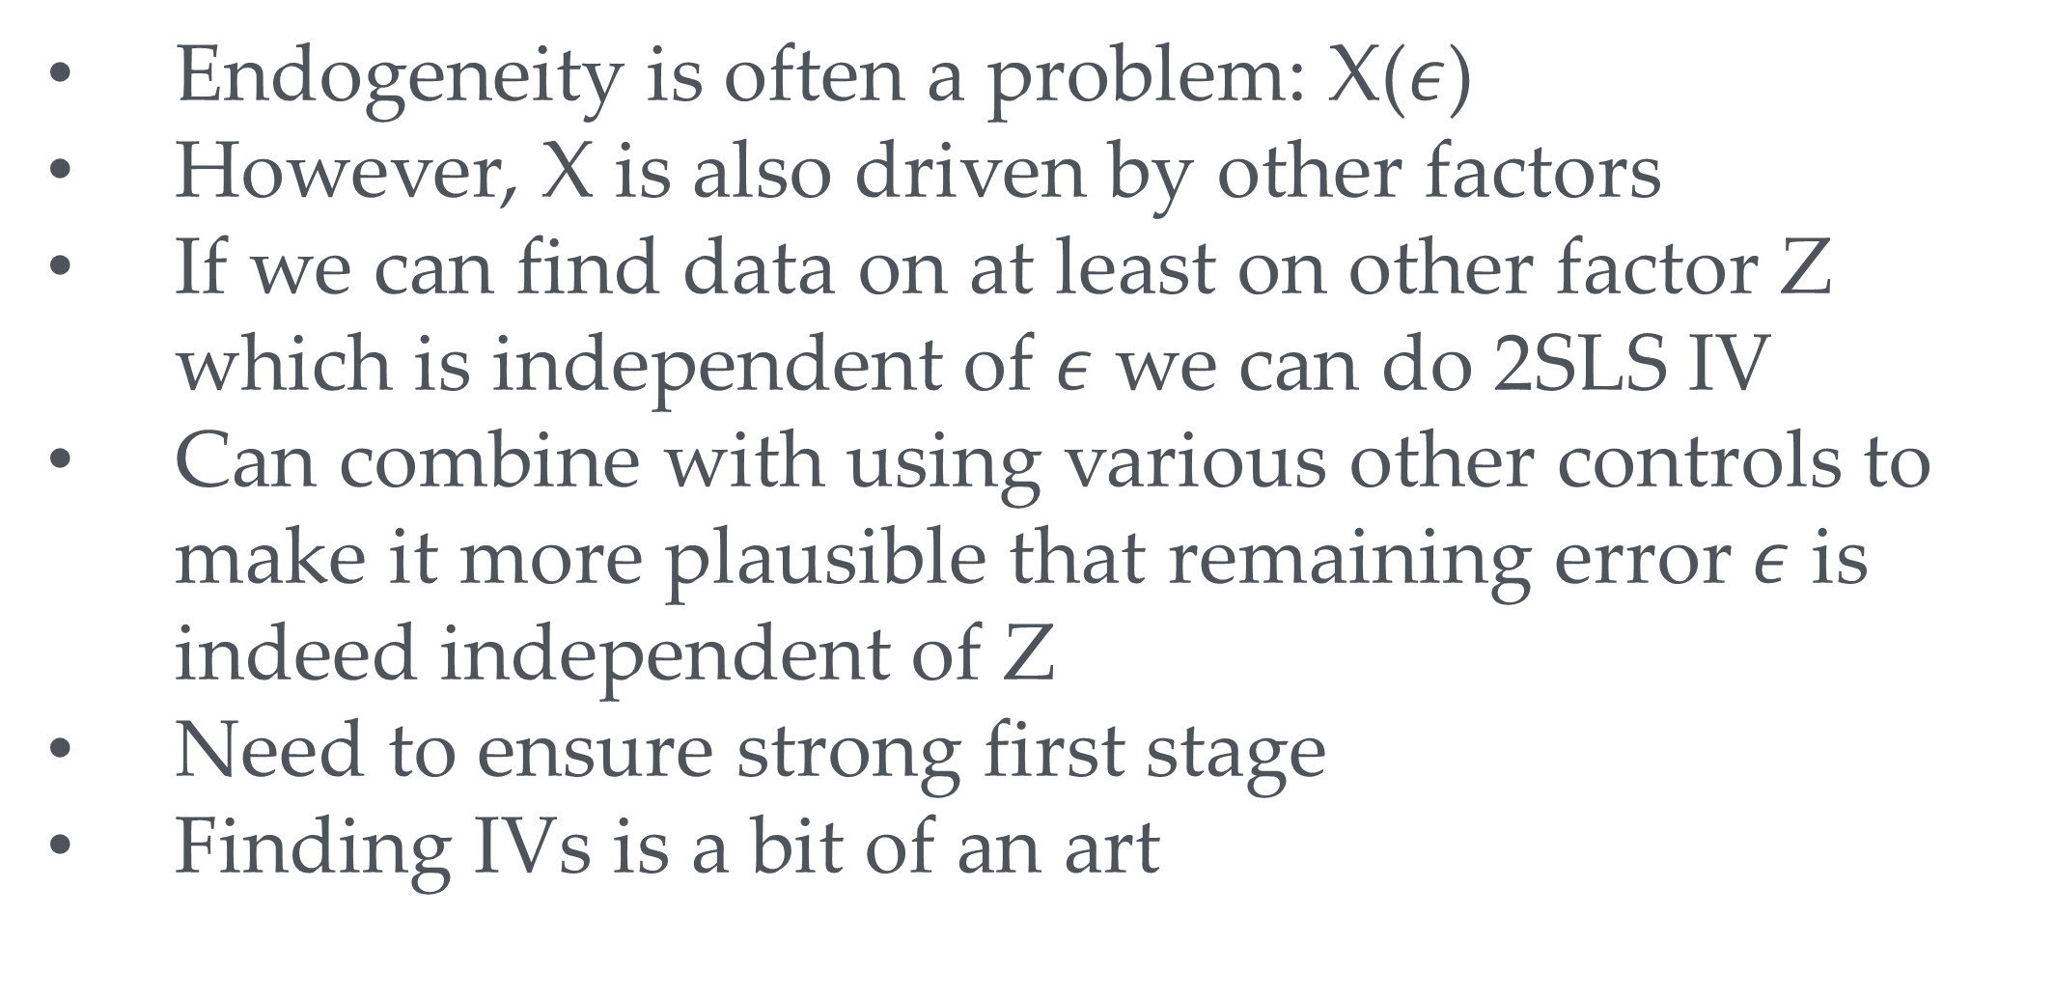
Summary
→
Endogeneity is often a problem: X($ε$)
However, X is also driven by other factors
If we can find data on at least on other factor Z which is independent of $ε$ we can do 2SLS IV
Can combine with using various other controls to make it more plausible that remaining error $ε$ is indeed independent of Z
Need to ensure strong first stage
Finding IVs is a bit of an art

